Slide 1

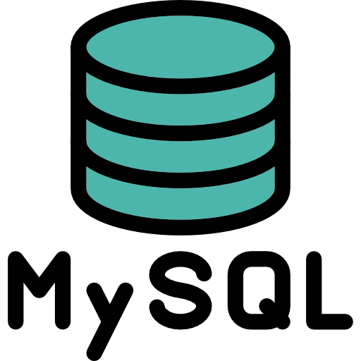

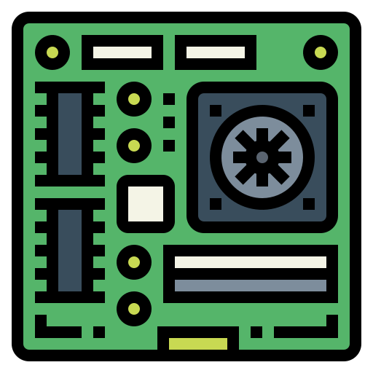
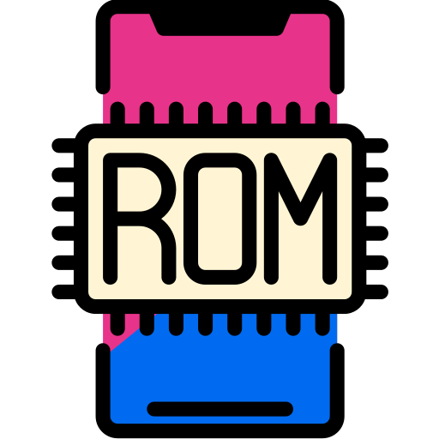
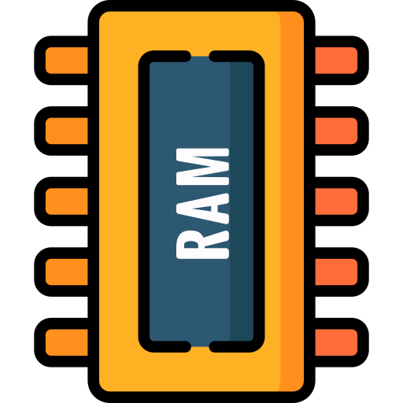
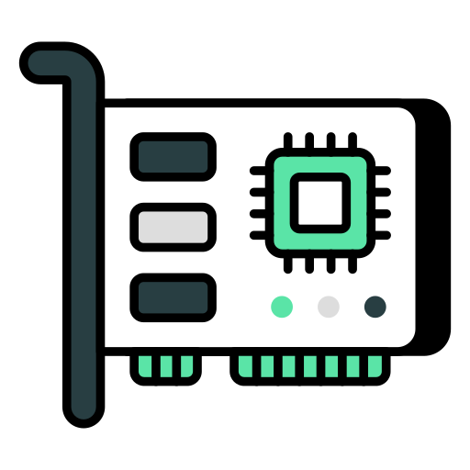

Hardware Virtualization Vs Operating System Virtualization
Architecture of Physical Servers (Machines):
Physical server architecture refers to the design and components of a physical server, which provides the hardware infrastructure for processing, storage, networking, and power management. This type of server is commonly used in data centers and enterprise environments to host applications, databases and services.
Hardware
Operating System
Application 1
Application 2
Physical Machine

Slide 2
Hardware Virtualization Vs Operating System Virtualization
Problems Associated with Physical Servers (Machines):
Physical servers have been a foundational component of IT infrastructure for many years. While they offer advantages such as reliability and performance, they also come with their fair share of challenges.
Here are some common physical server challenges:
Limited Scalability
High Maintenance Costs
Resource Wastage
No Multi-OS Support
Limited Disaster Recovery Options
Space Constraints
High Energy Consumption
Long Deployment Times
Lack of Flexibility
Obsolete Hardware
Vendor Lock-In Problems
Complex Backup and Recovery

Slide 3
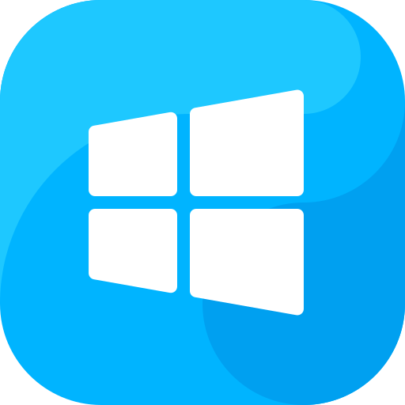

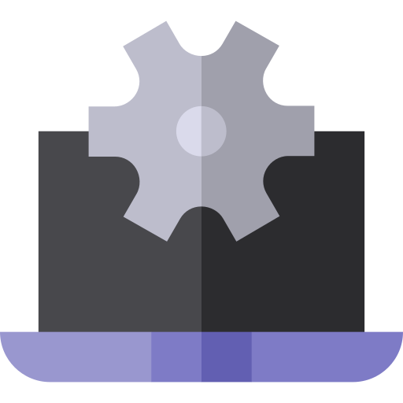
Hardware Virtualization Vs Operating System Virtualization
Solution: Hardware Virtualization (Hypervisor-Based Virtualization)
Hardware virtualization involves creating virtual machines (VMs) on top of a physical machine, with each VM running a full operating system and virtual hardware components.
Hardware
Host Operating System
Hypervisor
VM 1
VM 2
How it Works:
A hypervisor (Type 1 or Type 2) sits on top of the hardware and abstracts physical resources (CPU, memory, storage, etc.), allocating them to each VM as needed.
Examples of Hypervisors:
Type 1 (Bare-Metal):
VMware ESXi
Microsoft Hyper-V
Xen
Type 2 (Hosted):
Oracle VirtualBox
VMware Workstation
Guest OS
Guest OS
App 1
App 2
Physical Machine

Slide 4
Hardware Virtualization Vs Operating System Virtualization
Problems With Hardware Virtualization (Hypervisor-Based Virtualization)
Some common problems and challenges are as follows:
Performance Overhead: Virtualization introduces additional layers between hardware and applications, which can lead to performance degradation compared to running directly on physical hardware.
Resource Contention: When multiple VMs share the same physical resources, heavy workloads can compete for CPU, memory and I/O, causing performance bottlenecks and potentially impacting all VMs.
Hardware
Host Operating System
Hypervisor
VM 1
VM 2
Guest OS
Guest OS
App 1
App 2
Physical Machine

Slide 5
Hardware Virtualization Vs Operating System Virtualization
Problems With Hardware Virtualization (Hypervisor-Based Virtualization)
Complex Management: Managing large numbers of VMs, storage, and network configurations can be complex and requires specialized tools and skills, increasing the administrative burden.
Security Risks: Vulnerabilities in the hypervisor could potentially allow attackers to escape a VM and access other VMs or the host, posing security risks in multi-tenant environments.
Hardware
Host Operating System
Hypervisor
VM 1
VM 2
Guest OS
Guest OS
App 1
App 2
Physical Machine

Slide 6
Hardware Virtualization Vs Operating System Virtualization
Problems With Hardware Virtualization (Hypervisor-Based Virtualization)
Licensing and Costs: Virtualization platforms often come with licensing fees, and hardware requirements may increase with virtualization, potentially offsetting some of the cost savings.
Backup and Recovery Complexity: While VMs can simplify some aspects of backup and recovery, virtualized environments require careful planning to ensure data consistency and manageable backup windows.
Hardware
Host Operating System
Hypervisor
VM 1
VM 2
Guest OS
Guest OS
App 1
App 2
Physical Machine

Slide 7
Hardware Virtualization Vs Operating System Virtualization
Problems With Hardware Virtualization (Hypervisor-Based Virtualization)
Hardware Compatibility Problems: Some virtualization platforms may not support all types of hardware or peripherals, limiting the ability to virtualize the certain applications.
Single Point of Failure: If a physical server fails, all VMs on that server go down. High-availability solutions exist, but they add complexity and cost.
Hardware
Host Operating System
Hypervisor
VM 1
VM 2
Guest OS
Guest OS
App 1
App 2
Physical Machine

Slide 8
Hardware Virtualization Vs Operating System Virtualization
Problems With Hardware Virtualization (Hypervisor-Based Virtualization)
Hypervisor Overhead and Maintenance: Hypervisors require regular updates and patches to address bugs and security vulnerabilities, which can introduce downtime and require careful maintenance.
Scalability Limits: As the number of VMs increases, resource contention and performance degradation can become more pronounced, requiring careful resource allocation and potentially additional physical hardware.
Hardware
Host Operating System
Hypervisor
VM 1
VM 2
Guest OS
Guest OS
App 1
App 2
Physical Machine

Slide 9
Hardware Virtualization Vs Operating System Virtualization
Problems With Hardware Virtualization (Hypervisor-Based Virtualization)
Latency in Real-Time Applications: Virtualization can introduce latency, making it less suitable for real-time or latency-sensitive applications compared to running on bare metal.
Skill and Knowledge Requirements: Managing virtualized environments requires specialized expertise in hypervisors, networking, and storage, and these skills may need regular updates as technologies evolve.
Hardware
Host Operating System
Hypervisor
VM 1
VM 2
Guest OS
Guest OS
App 1
App 2
Physical Machine

Slide 10
Hardware Virtualization Vs Operating System Virtualization
Solution: OS Virtualization (Containerization)
OS virtualization allows for multiple isolated user-space instances (containers) on a single host OS, sharing the same kernel.
How it Works: Containers run on top of a container engine (like Docker or Podman) within the same OS kernel, isolating applications but using shared resources more efficiently.
Examples of Container Engines:
Docker, Podman, Kubernetes (for orchestrating containers)
Advantages:
Lightweight: Containers use fewer resources than VMs because they share the host OS kernel.
Fast Boot Time: Containers start much faster than VMs, enhancing efficiency in development and deployment.
Use Cases:
Microservices architecture.
Application development and testing.

Slide 11
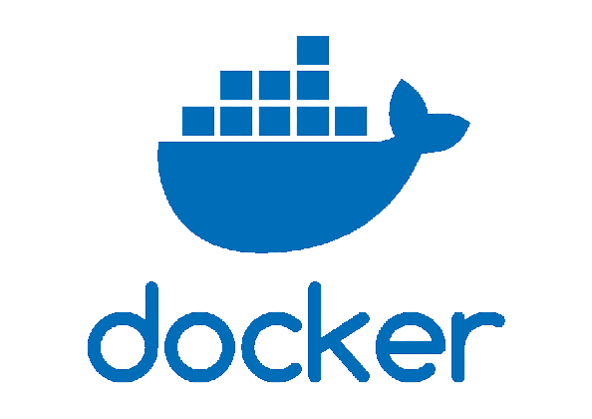
Hardware Virtualization Vs Operating System Virtualization
Solution: OS Virtualization (Containerization)
Physical Or Virtual Machine
Operating System (Host)
Container Engine
Container 1
Container 2
Bin/Lib
Bin/Lib
App 1
App 2

Slide 12
Hardware Virtualization Vs Operating System Virtualization
Hardware Virtualization Vs Operating System Virtualization:
Hardware
Physical Or Virtual Machine
Host Operating System
Operating System (Host)
Hypervisor
Container Engine
VM 1
VM 2
Container 1
Container 2
Guest OS
Guest OS
Bin/Lib
Bin/Lib
App 1
App 2
App 1
App 2
Hardware Virtualization (Virtual Machines)
OS Virtualization (Containers)

Slide 13
Hardware Virtualization Vs Operating System Virtualization
Feature | Hardware Virtualization | OS Virtualization
Definition | Virtualizes the entire hardware stack to run multiple OSs | Virtualizes the OS layer to run multiple instances of the OS
Virtualization Layer | Hypervisor (Type 1 or Type 2) | Container Engine (Docker, Podman, etc.)
Isolation Level | High (each VM runs its own OS) | Medium (containers share the host OS kernel)
Resource Overhead | Higher due to full OS emulation and hardware abstraction | Lower as containers share the host OS and its resources
Startup Time | Slower (booting a full OS) | Faster (container processes start directly)
Use Cases | Running multiple OS types, legacy applications | Microservices, lightweight app deployment, CI/CD
Guest OS Requirements | Can run different OSs (e.g., Windows, Linux) | Usually the same OS as the host (e.g., Linux on Linux)
Performance | Slightly lower due to the hypervisor overhead | Higher as containers share the same OS and resources
Security | Strong isolation between VMs | Moderate; containers are isolated but share the same OS kernel
Scalability | Limited by heavier resource requirements of VMs | Highly scalable with lower resource requirements
Resource Utilization | Lower resource efficiency due to OS duplication | High resource efficiency with shared OS kernel
Management Complexity | More complex (requires VM management, OS updates per VM) | Easier with container orchestration (e.g., Kubernetes)
Examples | VMware, Hyper-V, KVM | Docker, LXC, Podman

